Slide 1
Factor analysis
Higher School of Economics, 2020
Author: Alisa Melikyan, senior lecturer of the School of Software Engineering

Slide 2
About factor analysis
Factor analysis is a data reduction technique used to reduce a large number of variables to a smaller set of underlying factors that summarize the essential information contained in the variables. More frequently, factor analysis is used as an exploratory technique when the researcher wishes to summarize the structure of a set of variables.

Slide 3
Uses of the factor analysis
1) To understand the structure of a set of variables (e.g. pioneers of intelligence such as Spearman and Thurstone used factor analysis to try to understand the structure of the latent variable “intelligence”);
2) To construct a questionnaire to measure an underlying variable (e.g. designing a questionnaire to measure burnout);
3) To reduce a data set to a more manageable size while retaining as much of the original information as possible (e.g. multicollinearity can be a problem in multiple regression; factor analysis can be used to solve this problem by combining variables that are collinear).

Slide 4
Steps of the factor analysis
Computation of the correlation matrix – to determine the appropriateness of the factor analytic model;
Factor extraction – to determine the number of factors necessary to represent the data;
Rotation – to make the factor structure more interpretable.

Slide 5
Assumptions
There are a number of assumptions and practical considerations underlying the application of the factor analysis:
Sample size – a minimum of five subjects per variable is required for factor analysis. A sample of 100 subjects is acceptable, but sample sizes of 200+ are preferable.
Linearity – because factor analysis is based on correlation, linearity is important. If linearity is not present, the solution may be degraded.
Outliers among cases – factor analysis is sensitive to outlying cases. These cases need to be identified and analyzed attentively.
Factorability of the correlation matrix – a correlation matrix that is appropriate for factor analysis will have several sizeable correlations.

Slide 6
Correlation matrix
R-matrix (or correlation matrix) represents the correlation between each pair of selected variables. The existence of clusters of large correlation coefficients between subsets of variables suggests that those variables could be measuring aspects of the same underlying dimension. These underlying dimensions are known as factors (or latent variables).
By reducing a data set from a group of interrelated variables into a smaller set of factors, factor analysis achieves parsimony by explaining the maximum amount of common variance in a correlation matrix using the smaller number of explanatory concepts.

Slide 7
Example
We want to measure different aspects of what might make a person popular. We will measure several aspects of person’s popularity:
1) Social Skills;
2) Selfishness;
3) Interest (how interesting others find them);
4) Talk 1 (the proportion of time they spend talking about the other person during a conversation);
5) Talk 2 (the proportion of time they spend talking about themselves);
6) Liar (propensity to lie to people).

Slide 8
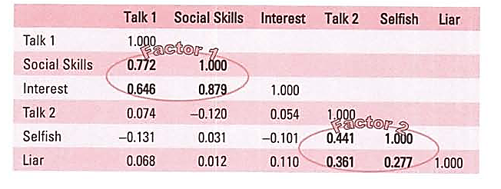
Example: correlation matrix
There are two clusters of interrelating variables. Therefore, these variables might be measuring some common underlying dimensions.
Factor 1: the better your social skills the more interesting and talkative you are likely to be.
Factor 2: selfish people are likely to lie and talk about themselves.

Slide 9
Analyzing R-matrix
In factor analysis we strive to reduce the R-matrix to its underlying dimensions by looking at which variables seem to cluster together in a meaningful way. This data reduction is achieved by looking for variables that correlate highly with a group of other variables, but do not correlate with variables outside of that group.
In our example there appear to be two clusters:
1) General sociability;
2) Consideration (the way in which a person treats others socially).

Slide 10
Graphical representation of factors
Factors are statistical entities that can be visualized as classification axes along which measurement variables can be plotted, e.g. if we imagine factors being the axis of a graph, then we can plot variables along these axes. The co-ordinates of variables along each axis represent the strength of relationship between that variable and each factor.

Slide 11
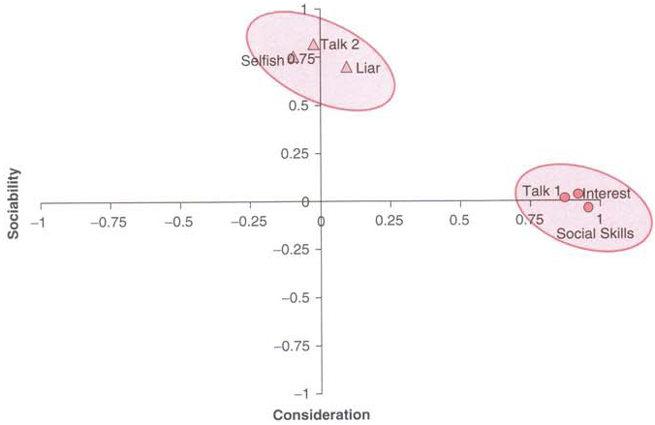
Factor plot

Slide 12
Explaining the factor plot (1)
We have two factors. For both factors the axis line ranges from -1 to 1, which are the outer limits of a correlation coefficient. Therefore, the position of a given variable depends on its correlation to the two factors.
The circles represent the three variables that correlate highly with factor 1 (sociability: horizontal axis), but have a low correlation with factor 2 (consideration to others: vertical axis). Conversely, the triangles represent variables that correlate highly with consideration to others, but have a low correlation to sociability.

Slide 13
Explaining the factor plot (2)
The co-ordinates of a variable represent its relationship to the factors. In an ideal world a variable should have a large co-ordinate for one of the axes, and low co-ordinates for any other factors. This scenario would indicate that this particular variable related to only one factor. Variables that have large co-ordinates on the same axis are assumed to measure different aspects of some common underlying dimension.

Slide 14
Factor loading
The co-ordinate of a variable along a classification axis is known as a factor loading. The factor loading can be thought of as the Pearson correlation between a factor and a variable. The squared factor loading is a measure of the substantive importance of a particular variable to a factor.
The factor loading tells us about the relative contribution that a variable makes to factor.

Slide 15
Factor equation
Factor_{i} = b₁*Variable₁ + b_{n}*Variable_{n} +E_{i}
b_{n} – factor loading
Sociability = 0,87*Talk1 + 0.96* Social Skills + 0,92* Interest + 0,00*Talk 2 + 0,10*Selfish + 0,09*Liar + E

Slide 16
Factor rotation
Factor rotation effectively rotates the factor axes such that variables are loaded maximally to only one factor.
Rotation may be:
orthogonal (factors are uncorrelated with one another) or
oblique (factors are allowed to correlate).
The choice of rotation is both empirically and theoretically driven.

Slide 17
Methods of factor rotation
SPSS has three methods of orthogonal rotation:
- varimax,
- quartimax,
- equamax
and two methods of oblique rotation:
- direct oblimin,
- promax.
These methods differ in how they rotate the factors and, therefore, the resulting output depends on which method you select.

Slide 18
Method of orthogonal rotation: varimax
Varimax attempts to maximize the dispersion of loadings within factors. Therefore, it tries to load a smaller number of variables highly onto each factor resulting in more interpretable clusters of factors.

Slide 19
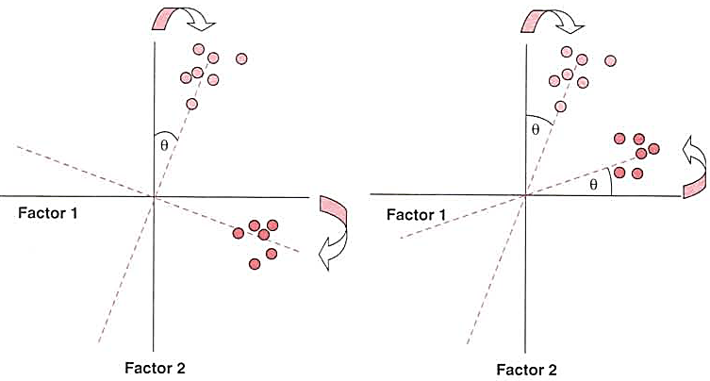
Factor rotation
Orthogonal rotation
Oblique rotation

Slide 20
Measure of sampling adequacy
The Kaiser-Meyer-Olkin measure of sampling adequacy (KMO) represents the ratio of the squared correlation between variables to the squared partial correlation between variables. The KMO statistic varies between 0 and 1.
“0” – indicates the diffusion in the pattern of correlations (factor analysis is likely to be inappropriate).
“1” – indicates that factor analysis should yield distinct and reliable factors.

Slide 21
Factor Analysis in Stata (1)
factor var1 var2 var3, pcf
We keep 3 factors with Eigenvalue greater than 1. Eigenvalues show the total variance accounted by each factor.
Amount of variance explained by 3 factors

Slide 22
Factor analysis in Stata (2)
Factor loadings are the weights and correlations between each variable and the factor.
Uniqueness is the variance that is ‘unique’ to the variable and not shared with other variables.

Slide 23
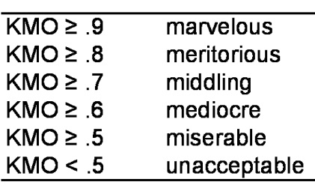
KMO in Stata
estat kmo, novar

Slide 24
Factor rotation
rotate, blanks(.3)

Slide 25
Saving factors as variables and graphs
screeplot, yline(1)
predict factor1 factor2 factor3
loadingplot //for two factors
scoreplot //for two factors
global id make
scoreplot, mlabel ($id) //for two factors

Slide 26
Interesting links
http://setosa.io/ev/principal-component-analysis/
https://dss.princeton.edu/training/Factor.pdf
https://stats.idre.ucla.edu/stata/output/factor-analysis/

